Slide 1

Milk It: A Crash Course in Conceptualizing and
Creating Defusion
Chad E. Drake & Travis Sain
Southern Illinois University

Slide 2
My goals in this workshop
to give you a background in theory and research on defusion
and a basic protocol for teaching defusion to others
in the hopes it will amplify your creativity, effectiveness… and perhaps your own psychological flexibility

Slide 3
why I’m here
and
what I’m hoping for

Slide 4
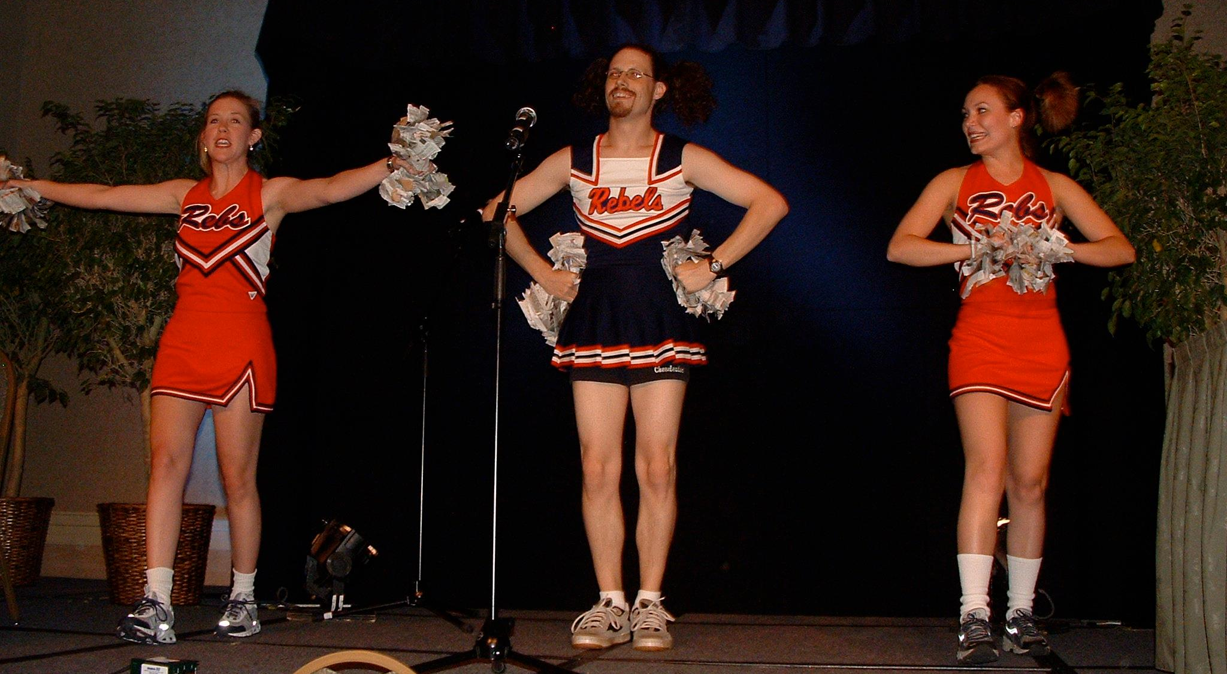
My Values Are More Important Than My Mind’s Judgments about My Public Behavior
Notes:
I know what it is like to live under the gun – under pressure and intimidation provided by my own mind.

Slide 5


Slide 6
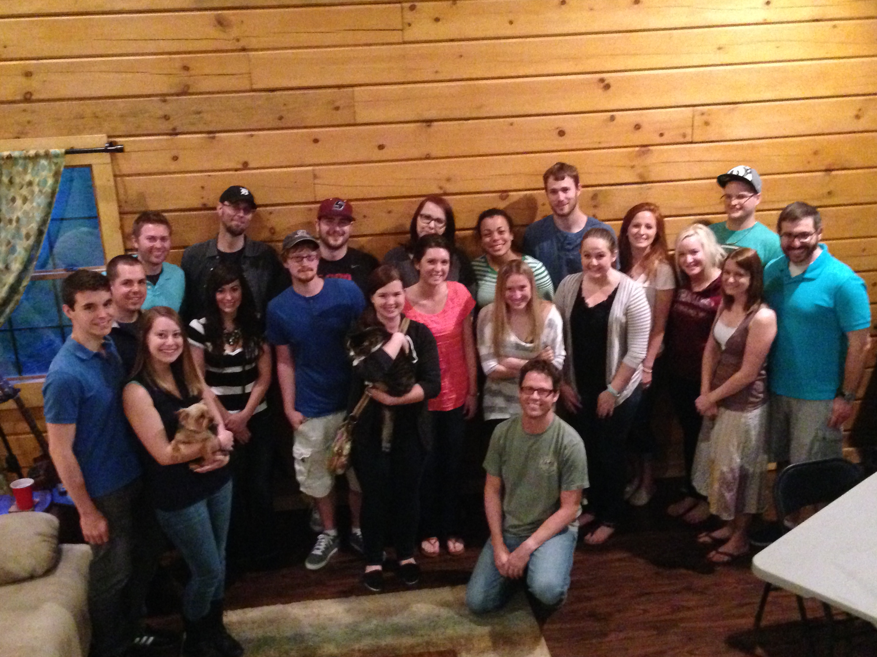

Slide 7
How would you characterize
the context of this conversation
here and now?
Notes:
I am attempting to increase verbal governance of your behavior
I am attempting to augment your behavior
But humans frequently are augmented for unworkable motives, via dysfunctional behaviors, for unfulfilling outcomes

Slide 8



“playful seriousness…
…and a serious playfulness”
Notes:
there is a constant interplay between embracing and letting go of the influence of words

Slide 9
My Request
bring with you here today those words that are most difficult for you
or those words that are required for you
and deeply value building a repertoire of defusion with them
Notes:
have people write down at least 3 words that are painful and/or debilitating

Slide 10
Zen Master Guichen said, “Where are you going?”
Fayan replied, “On an ongoing pilgrimage.”
Guichen said, “Why do you go on a pilgrimage?”
Fayan replied, “I don’t know.”
Guichen said, “Not knowing is most intimate.”
-from the record of Master Fayan Wenyi
Notes:
Sometimes knowing is overrated.
I want to be able to live life more in response to what is actually happening and is actually possible, and less in response to the rules that my mind says I am supposed to live by.
My hope in this workshop is that you will be willing to put knowing aside, and to let yourself not know and to let yourself abstain from trying to know
And instead just be on an odd pilgrimage with me today

Slide 11
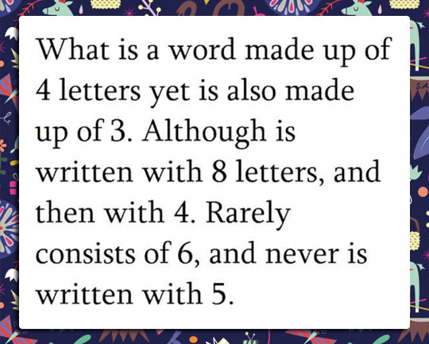
Here’s a Puzzle
Notes:
talk about words that you could insert here that would still be correct, but you are reluctant to do so because of potential problems with the audience

Slide 12
Here’s a Puzzle
Dumb
bad is also made
Unwanted
ugly
Stupid
loser
Notes:
talk about words that you could insert here that would still be correct, but you are reluctant to do so because of potential problems with the audience

Slide 13
Ear Burners
sticks and stones
may break your bones
but words will never hurt you
but words may defy social norms and result in condemnation

Slide 14
Take This Literally
Plan to be spontaneous.
Try really hard to relax.
Be lovingly hateful.
Understand the unknowable.
These are just words.
All words are lies.
Defusion as an experience transcends literality.
Notes:
the context of literality is so powerful and persuasive, that it makes sense that people have difficulties understanding or appreciating it
that being said, perhaps we could commit ourselves this morning to a thorough understanding of these rules
although…these rules do not adequately convey the experience of defusion, because defusion involves dysregulating the typical literality of words

Slide 15
Here’s a Secret
This defusion workshop is going to teach you what defusion is as well as ways to do it…
but also, a bit about:
  present moment awareness
  self-as-context
  acceptance
  and maybe valuing and committed action

Slide 16
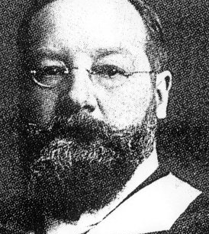
Say It Again
(And Again)
(And Again)
(And Again)
(And Again)
The Word Repetition Technique (WRT)
Titchener
Semantic satiation

Slide 17
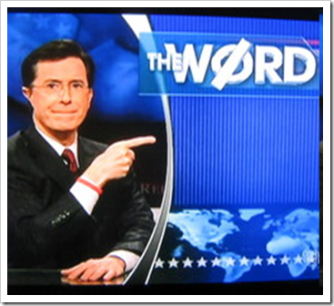
Let’s do the milk exercise.
What did you notice?
Bacon

Slide 18
Some Possible Noticings
auditory properties of the sound
tactile sensations of the lips, mouth, and throat
qualities of respiration
visual observations
associated thoughts and memories
and, of course, changes in the emotional valence and meaningfulness of the word

Slide 19
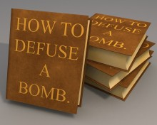
Reviewing Some Evidence

Slide 20
Masuda et al. (2008)
Notes:
empirically based conclusion #1: duration of the wrt matters, and matters differentially

Slide 21
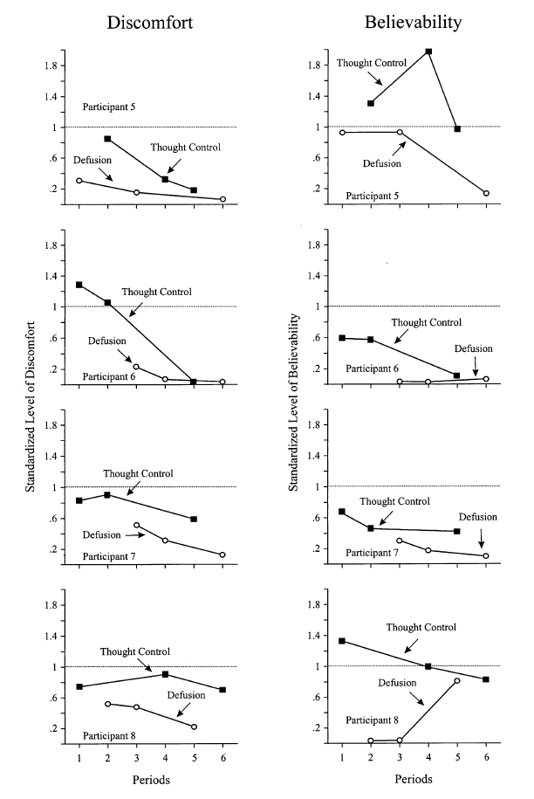
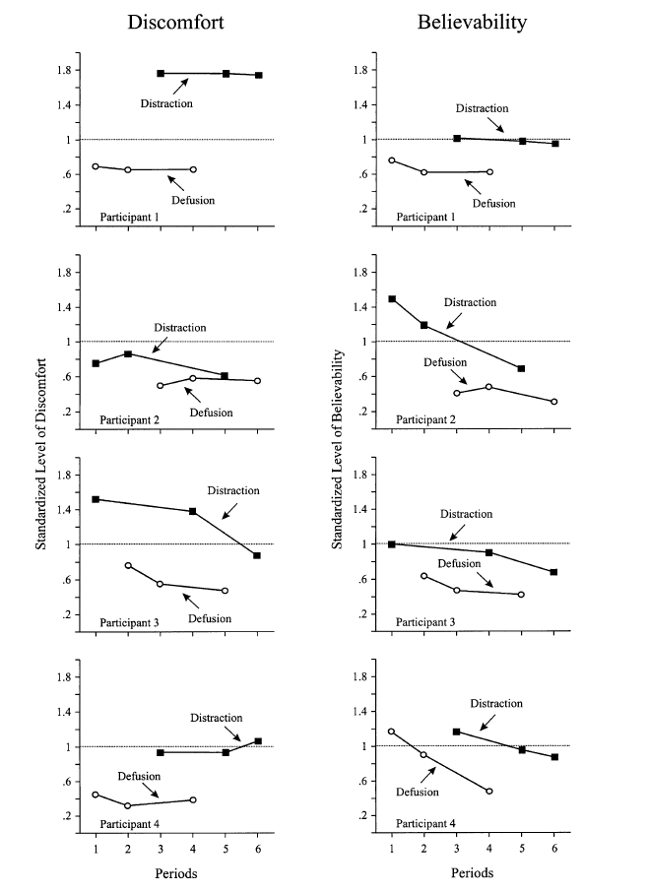
Masuda et al. (2004)
Study 1
Study 2
Notes:
empirically based conclusion #2: wrt works better than distraction and suppression

Slide 22
Masuda, Twohig, et al. (2010)
Discomfort
Believability

Slide 23
Masuda, Feinstein, et al. (2010)
Discomfort
Believability
Notes:
partial defusion = rationale + generic example
full defusion = rationale + generic example + personally relevant example
empirically based conclusion #3: ideographic defusion works better than nomothetic

Slide 24
Watson et al. (2010)
Study 1
Study 2
Aggregated negative appraisal ratings for contamination-related thoughts
Notes:
sample reported high contamination fear
study 1 was a small dose intervention and was not statistically significant at followup
study 2 was a larger intervention dose and was significantly at followup
empirically based conclusion #4: wrt words better when provided in larger doses and better than a common behavioral technique of known efficacy

Slide 25
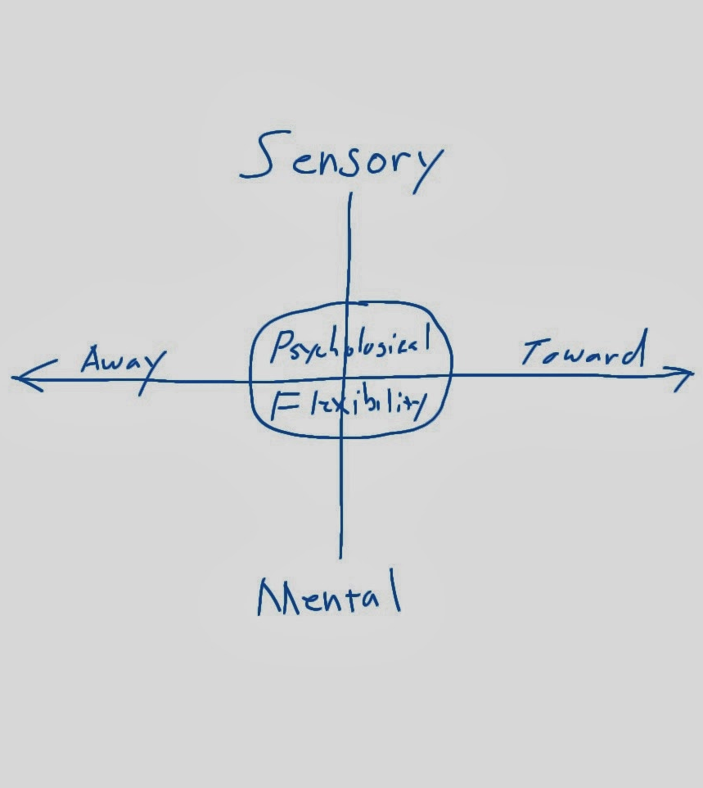
So…
What IS defusion?
The easy answer is to say it is an element of psychological flexibility…

Slide 26
self-as-process
acceptance
values
psychological
flexibility
defusion
committed action
self-as-context

Slide 27

Hayes et al., 2004
“…the ability to contact the present moment more fully as a conscious human being, and to either change or persist when doing so serves valued ends.” (p. 5)

Slide 28

Luoma, Hayes, & Walser, 2007
“…the ability to contact the present moment more fully as a conscious human being, and based on what the situation affords, to change or persist in behavior in order to serve valued ends.” (p. 17)

Slide 29

Hayes et al., 2007
“…the ability to experience events fully, consciously, and without defense, and to persist in or change behavior in a given situation in the service of chosen values.” (p. 57)

Slide 30

Hayes et al., 2012
“…contacting the present moment as a conscious human being, fully and without needless defense – as it is and not as what it says it is – and persisting with or changing behavior in the service of chosen values.” (p. 96-97)

Slide 31
self-as-process
acceptance
values
psychological
flexibility
defusion
committed action
self-as-context

Slide 32
self-as-process
acceptance
values
defusion
committed action
self-as-context

Slide 33
self-as-process
acceptance
values
defusion
committed action
self-as-context
Notes:
Defusion and acceptance; similar in that they disrupt contingencies between private events and behavior; different in their focus – words with defusion, emotions with acceptance
Defusion and self-as-process; similar in that they promote awareness that is detached from history; different in their focus – words with defusion, self-awareness with self-as-process
Defusion and self-as-context; similar in that they promote a detachment from verbal content; different in their focus – words with defusion, self-awareness with self-as-context
Defusion and acceptance; similar in that they disrupt contingencies between private events and behavior; different in their focus – words with defusion, emotions with acceptance
Defusion and values; similar in that they promote appetitive influence and disrupt aversive influence; different in their focus – diminishing verbal influence with defusion, enhancing verbal influence with values
Defusion and committed action; similar in that they both involve engagement in respect to cognitive content; different in their focus – less verbal governance with defusion, more verbal governance with committed action

Slide 34

Hayes, Strosahl, & Wilson, 1999
“To deliteralize means to disrupt ordinary meaning functions of language such that the ongoing process of framing events relationally is evident in the moment and competes with the stimulus products of relational activity. Deliteralization breaks down the tight equivalence classes and dominant verbal relations that establish stimulus functions through verbal means” (p. 74)
“Deliteralization involves establishing contexts in which the distinction between derived and direct stimulus functions is more experientially evident, and in which verbal stimuli have multiple effects, only some of which are derived.” (p. 150)

Slide 35
Luoma, Hayes, & Walser, 2007
“Defusion… refers to the process of creating nonliteral contexts in which language can be seen as an active, ongoing, relational process that is historical in nature and present in the current moment.” (p. 18)

Slide 36
Hayes, Strosahl, & Wilson, 2012
“…defusion methods attempt to alter the functional context of minding so that it is possible to appreciate the process of thinking and feeling, not just the content of those activities.” (p. 71)
“Defusion methods reduce the transformation of stimulus functions by altering the cues and contexts that support fusion.” (p. 71)
Separating “…ongoing cognitive process from its cognitive products.” (p. 244)
“…making closer contact with verbal events as they really are, not merely as what they say they are.” (p. 244)

Slide 37

Harris, 2009
“Defusion means separating or distancing from our thoughts, letting them come and go instead of being caught up in them. In other words, defusion means
  looking at thoughts rather than from thoughts
  noticing thoughts rather than being caught up in thoughts; and
  letting thoughts come and go rather than holding on to them” (p. 97)

Slide 38
Luciano, et al., 2011
“Defusion interactions in ACT are oriented to promote the discrimination of the ongoing process of having any thought or feeling as well as to discriminate the person who is having each of them. These interactions aim to promote the experience of self-as-context as a consistent perspective in order to alter the functions of those thoughts and feelings.” (p. 166)

Slide 39
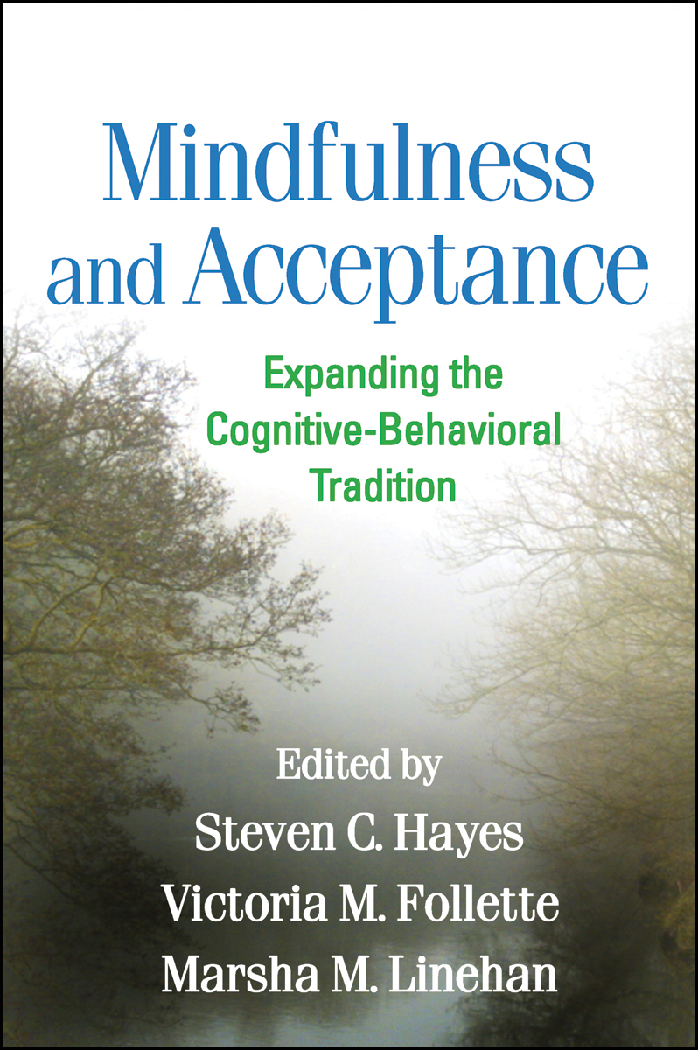
Wilson & Murrell, 2004
“Cognitive defusion… refers to procedures that broaden repertoires with respect to stimuli that have acquired their psychological functions through relational (or verbal) processes.” (p. 131)

Slide 40
Forman, et al., 2012
“Defusion refers to a state of mind wherein one achieves psychological distance from subjective experiences, seeing them merely as psychological events or states rather than as literal, truth-based interpretations of reality (Blackledge, 2007; Masuda, Hayes, Sackett, & Twohig, 2004).” (p. 55)
“…cognitive defusion refers to the process by which thoughts are viewed as simply thoughts rather than absolute truths, and thus the disabling function of such a thought is interrupted (Blackledge, 2007). Clinically, defusion is the ability to step back from or distance oneself from one’s subjective experience in a manner that enables patients to see that their thoughts are ‘‘just thoughts’’ that need not be believed nor disbelieved (Hayes, 2004; Wilson & Roberts, 2002). As individuals begin to experience their thoughts less literally – observing them as just thoughts – they are able to respond in a manner consistent with chosen values rather than reacting to thoughts, worries, or sensations (Eifert et al., 2009).” (p. 56)

Slide 41
Blackledge, 2007
“Cognitive defusion is a process in which targeted verbal stimulus transformations are at least temporarily disrupted by the introduction of contextual cues that displace key, ubiquitous features of the context of literality controlling the processes of relational responding that give rise to verbal stimulus transformations in general. Colloquially, defusion occurs when language-use conventions are violated to the point that specific words or phrases lose their ability to make these words’ abstract referents psychologically present and appear to exert control over subsequent behavior.” (p. 8)

Slide 42
In Summary
conscious experience in the moment
awareness of the process of thinking
involves the creation of nonliteral contexts
meaning of thoughts is disrupted/diminished
getting distance from thoughts
distinguishing self from thoughts
diversifying behavioral options

Slide 43
Purpose (function) of Defusion
to disrupt the meaning (stimulus functions) of a verbal/cognitive experience
  perhaps by minimizing the prevailing meaning
  but also by adding to the prevailing meaning
to disrupt the effect (response functions) of the experience
  perhaps by reducing the prevailing response
  but also by diversifying response options
to allow the workability of experiences to guide behavior when the prevailing meaning is not so workable

Slide 44
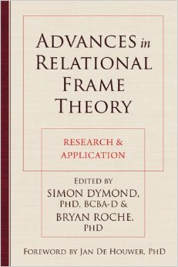
Blackledge & Drake, 2013
“…the act of discriminating between verbal and nonverbal stimulus functions.” (p. 241)
distinguishing the meaning of words from the physical properties of hearing, reading, thinking, or saying words
Notes:
in doing this, you are likely to be influencing the ability of the words to influence behavior based on their semantic functions

Slide 45
From Fusion to Defusion
the meaning and
behavioral implications
of the content
the sensory details of
seeing, hearing, and
saying the content
this circle represents verbal content that is experienced and responded to in a fused manner

Slide 46
Training Hexaflex Processes
provide a rationale
  motivation
provide a metaphor
  flexible rule for understanding it
provide an experiential exercise
  direct learning opportunity
provide a daily practice activity
  gain expertise and see relevance in daily life

Slide 47
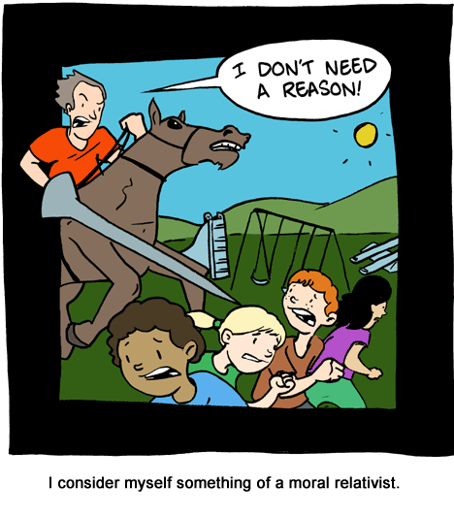
Rationales
Saturday Morning Breakfast Cereal; smbc-comics.com

Slide 48
A Experimental Rationale
Defusion is a skill that we apply to forms of language, such as written or spoken words, thoughts and beliefs, and rules that people follow in their lives.
The opposite of defusion is fusion. Most of the time, we are fused with all these forms of language. Fusion means we take words literally. That is, the meaning of words is taken seriously. When we are fused, the meaning of words may generate emotional reactions and also may control our behavior. This is not always a good thing.
Here’s a simple example of fusion. If you hear the word “milk”… a variety of things may enter your mind, such as an image of a glass of milk, or the word “creamy”, or you may think about a cow, or imagine the taste of milk, or you may remember something from your past involving milk, or any variety of other mental experiences. The key, though, is that these reactions occur to the word milk – there is no actual milk here right now, right? Fusion means that words can substitute for real things.
But “milk” is just a simple example – “milk” probably doesn’t generate any negative reactions for you. But sometimes people have thoughts that do have negative effects. It is not unusual for people to have negative evaluations about their self or their life, and these evaluations lead to unpleasant emotions and memories or hurtful and self-destructive behaviors. For example, if a person is strongly fused with the belief that they are worthless and that life is just pointless suffering, this may lead to depression and suicide. In this example, fusion with these words is destructive because it leads to problematic emotions and behaviors. This is an example where defusion skills can be helpful.
Defusion is a different way of viewing your own thoughts and beliefs. If you are experiencing defusion when you read the word milk, you might notice the shape, size, and color of the letters… if you say the word milk, you might notice the sensations of your lips, tongue, jaw, and throat as you say it… and if you hear the word milk, you might notice the volume and duration and number of syllables of this sound. What you won’t notice all that much is the meaning of the word. Instead, you notice the odd and silly properties of a word that we normally take literally.
Does this make sense? Defusion means you are focusing on the physical properties of reading, saying, and hearing a word, and not focusing so much on what the word means. You see past the meaning of a word and focus on the physical and sensory details that you experience with it.
Notes:
you may find it useful to explain fusion first, then explain defusion

Slide 49
A Simple Rationale
It is common for our concerns, judgments, and beliefs to control our behavior
Sometimes that control over our behavior is a problem in our lives
Defusion is a skill that changes how we view our problematic thoughts and beliefs
Defusion can liberate us from the control that thoughts often have over our behavior
When we practice defusion, we can choose more effective ways to behave in our lives

Slide 50
An Ideographic Rationale
collect data from the client regarding
  fused content
  behavior in response to fused content
  consequences of behavior in response to fused content
use examples to unworkability of these experienced verbal contingencies to justify learning about defusion

Slide 51
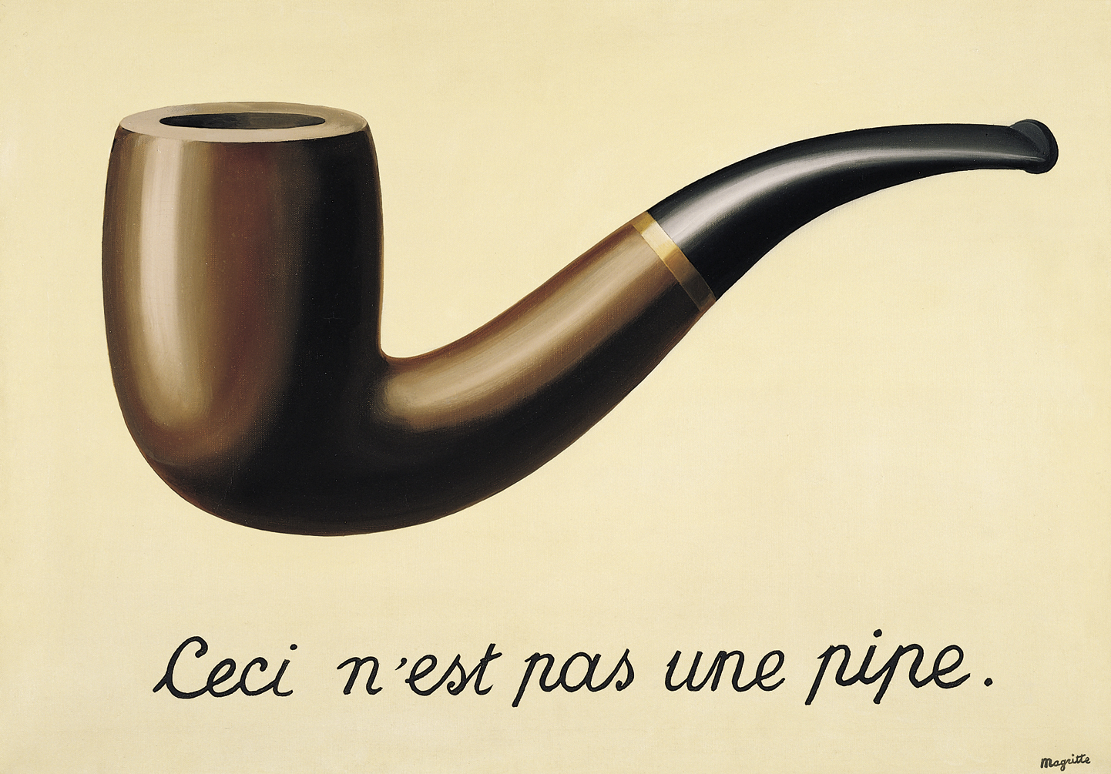
Metaphors

Slide 52
Some Defusion Metaphors
leaves on a stream metaphor
finding a place to sit metaphor
bad cup metaphor
passengers on the bus metaphor
mind as a radio metaphor
master storyteller metaphor
fish in the ocean metaphor

Slide 53
Defusion Analogies
Words are like…
Your mind is…
Beliefs are the same as…
Thinking is a…
A memory is similar to…

Slide 54

Let’s create some defusion analogies.
What did you create?

Slide 55

Experiential Exercises

Slide 56
General Tips for Defusion Work
normalize and welcome any and all thoughts
  all thoughts (yes, even that one) are sensible and acceptable reactions to the client’s history and current context
persistently distinguish the client and their mind
  instead of “you think ____”, say “your mind is saying ____”
#1

Slide 57
General Tips for Defusion Work
true thoughts are just thoughts, too
  “Maybe that is true. But tell me – is this thought helpful? When your mind presents that thought, does it lead you to experiences and places you want in your life? Does it get you what you want?”
attention can be directed from nonverbal to verbal and have defusion effects
  “Where does that urge live? What shape does it make in your body? If it were an animal, what animal would it be?”
#2

Slide 58
General Tips for Defusion Work
fused content doesn’t always justify defusion
  look for values relevance or gently offer some acceptance interventions
#3

Slide 59
Speech Modulation Activities
singing
pace changes
imitating voices/characters
rhythm disruptions
letter/syllable switches and recombinations

Slide 60
Visual Objectification Activities
words on a computer
writing statements on cards
using different fonts and colors
modifying letter/word orders
converting words into images
identifying the letters on a typewriter
writing various narratives

Slide 61
Behavioral Activities
paradoxical intention
behavioral experiments
being present to here and now
practicing acceptance
viewing experience from the observing self
connecting with values
engaging in a committed action

Slide 62
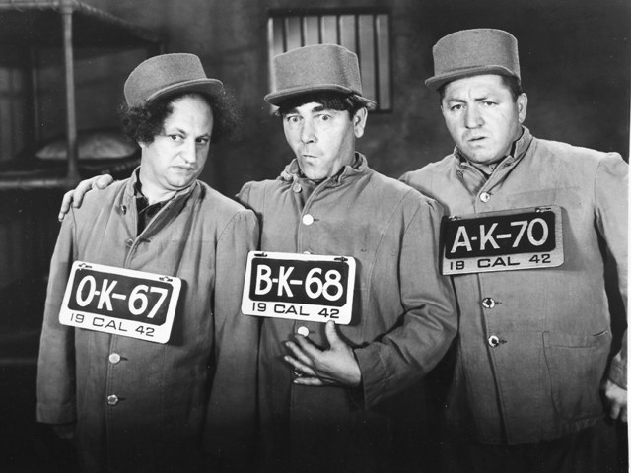
let’s do some defusion
Notes:
get into groups of 3
write one self-relevant word on a card
sit facing each other and display your card to the other 2 people
observe the cards, observe your partners, and observe your own reactions to the experience as it unfolds

Slide 63
Point to the word that
is the most depressing
is the most scary
is the shortest
is most temporary
is the longest
is the most different from bacon
is the least legible
is the fastest
is the most changeable
is the one you definitely don’t want
is most permanent
is the neatest
is the one you would choose if you had to choose one
is the easiest to measure
is the most wrong
is the funniest
is the slowest
is the most legible
is the most evaluative
is pointed to most frequently among the three of you
is pointed to the least among the three of you
is just some ink on a piece of paper

Slide 64
Are you defused?
Notes:
get into groups of 3
write one self-relevant word on a card
sit facing each other and display your card to the other 2 people
observe the cards, observe your partners, and observe your own reactions to the experience as it unfolds

Slide 65

Daily Practice

Slide 66
What Could You Do…
that would be inconsistent,
  disobedient,
    or just unrelated
      to those words you listed
that would give you more freedom
  to be who you want to be
    and to live how you want to live

Slide 67

let’s do something bold with our self-labels
Nameless A. Nonymous
Notes:
have participants come up with a creative way to write a label on their sticker

Slide 68
Some Possible Manipulations
font, capitalization, size, color, etc.
letter/syllable order
pair with unexpected adjectives or adverbs
convert into verbs
add extra syllables
include rhymes or repetitions
or whatever strikes you as seriously playful!

Slide 69

A Rule I’ve Followed
Stop following unhelpful rules all the time.
(some rules are more workable than others)
Don’t embarrass yourself.

Slide 70
There is so much more to life than can be experienced from inside the word machine…
I hope you can carry this work forward over the next few days and both experience and contribute to a vital and meaningful conference!

Slide 71
Milk It: A Crash Course in Conceptualizing and
Creating Defusion
chad.e.drake@gmail.com

